Slide 1


Slide 2
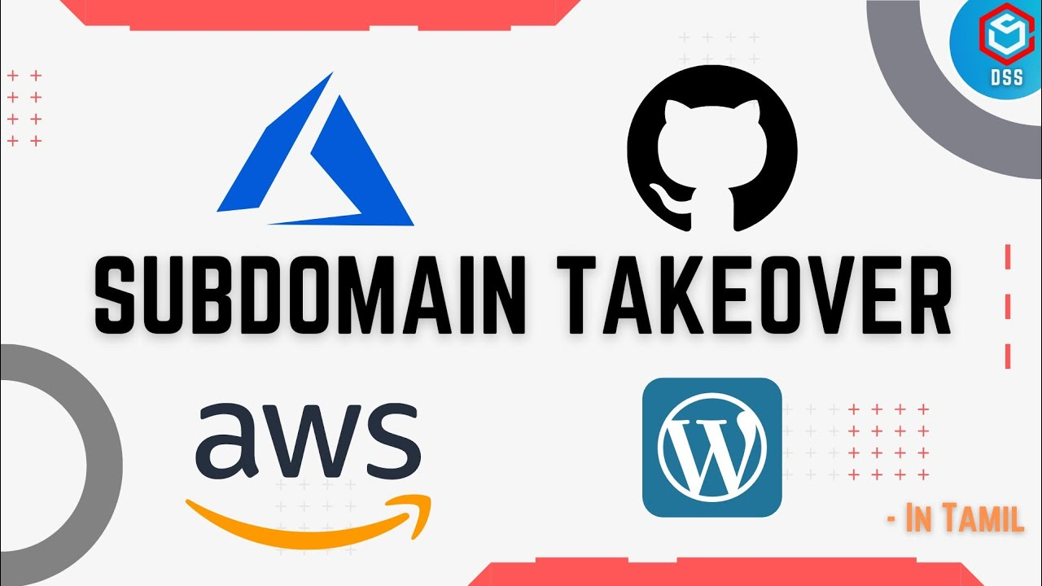

1. What is SUbDomain
2. What is SUbDomain takeover Vulnerability
3. How to find Vulnerable SUbDomain
4. impact of Subdomain takeover
5. Live Demo

Slide 3
What is SUbDomain
A subdomain is an additional part to your main domain name. Subdomains are created to organize and navigate to different sections of your website. You can create multiple subdomains or child domains on your main domain.
For example:
store.yourwebsite.com

Slide 4
What is SUbDomain takeover Vulnerability
A subdomain takeover occurs when an attacker gains control over a subdomain of a target domain.
Typically, this happens when the subdomain has a canonical name CNAME [A Canonical Name record is a type of resource record in the Domain Name System that maps one domain name to another. This can prove convenient when running multiple services from a single IP address] in the Domain Name System (DNS), but no host is providing content for it.

Slide 5
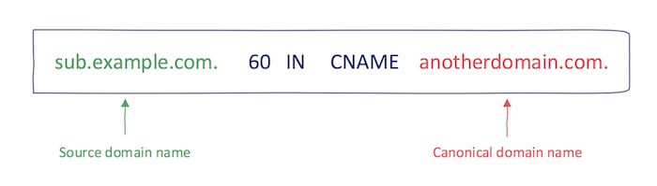
This can happen because either a virtual host hasn't been published yet or a virtual host has been removed.
An attacker can take over that subdomain by providing their own virtual host and then hosting their own content for it

Slide 6
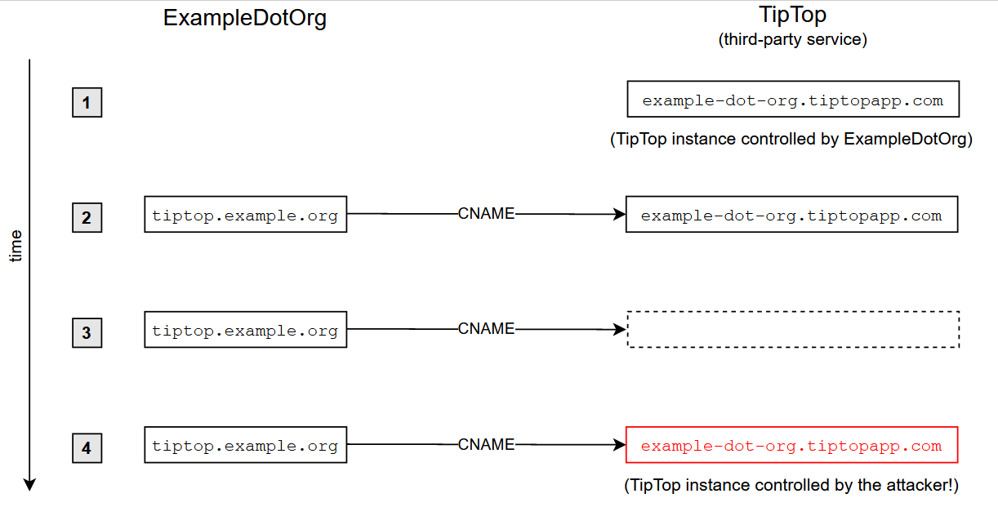
A Typical Scenario:
To fix ideas, let's go over a typical subdomain-takeover scenario. Let's assume that your organization, ExampleDotOrg, whose domain name is example.org, wants to use some service from a vendor called TipTop.

Slide 7
How to find Vulnerable SUbDomain
The first step is to list every subdomain of the web application using a subdomain discovery tool (such as subfinder, sublister, knockpy, amass, or turbolister) and save the results in a file.
The next step is to use tools to detect vulnerable subdomains to scan the subdomain file.
Subzy:
go get github.com/haccer/subjack
Subjack:
go get -u -v github.com/lukasikic/subzy
Tko-subs:
go get github.com/anshumanbh/tko-subs
Sub404:
git clone https://github.com/r3curs1v3-pr0xy/sub404.git

Slide 8
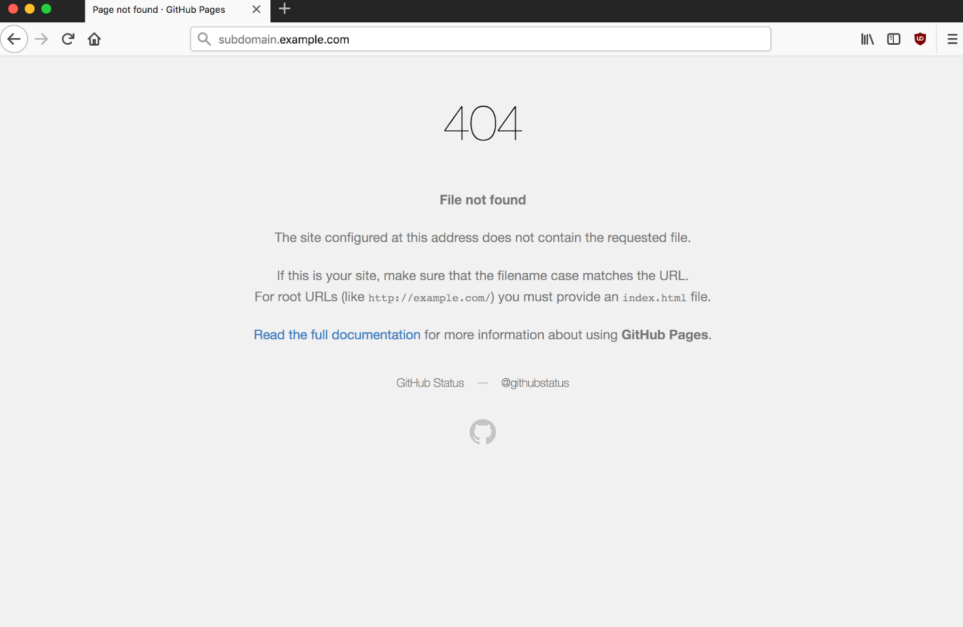
Use dig to check the CNAME of the subdomain. Then, you may check to takeover the subdomain using
Github
AWS S3
Shopify
Unbounce (etc)

Slide 9
impact of Subdomain takeover
Defacement: If possible, an attacker may decide to change the appearance of pages served by the vulnerable example.org subdomain to openly ridicule or embarrass your organization
Phishing: Another obvious way to exploit a subdomain vulnerable to takeover is phishing.
Stealing Broadly Scoped Cookies: Run-of-the-mill phishing typically requires some gullibility and user interaction (beyond navigating to the malicious site) from the victim. A subdomain takeover is more powerful, though, as it may enable an attacker to steal sensitive cookies simply by the victim visiting the attacker's site.

Slide 10
Subdomain takeover References
https://bughacking.com/best-subdomain-takeover-tools-for-bug-bounty-hunting/
https://0xpatrik.com/subdomain-takeover-basics/
https://www.honeybadger.io/blog/subdomain-takeover/
(You can see in this github repository which subdomains can be taken over)
https://github.com/EdOverflow/can-i-take-over-xyz
https://book.hacktricks.xyz/pentesting-web/domain-subdomain-takeover

Slide 11
THANK YOU

